Slide 1
Augmented Reality (AR)
DEEPALI KUMARI
AP22122040007

Slide 2
Content :
Augmented Reality
Augmented Reality vs. Virtual Reality
Feature
Feature Detection & Matching
Image Augmentation
Conclusion

Slide 3
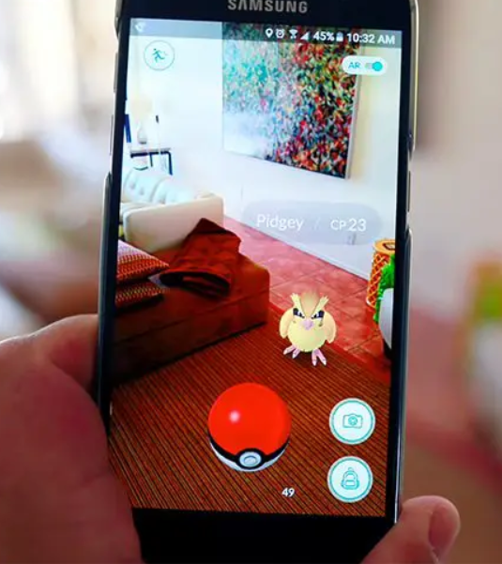
What is Augmented Reality?
Augmented reality is made up of the word “augment” which means to make something great by adding something to it.
So basically, augmented reality is a method by which we can alter our real world by adding some digital elements to it.
This is done by superimposing a digital image on the person’s current view thus it enhances the experience of reality.

Slide 4
Augmented Reality VS Virtual Reality
Virtual reality makes a virtual environment and puts the user in it whereas Augmented reality just adds the virtual components into the user’s real-world view.
Virtual reality sends a person into a virtual place created by a computer whereas augmented reality brings the digital world into our real world.
To experience virtual reality all you have to do is insert a smartphone, wear a headset, and immerse yourself in virtual reality.
For Augmented reality you only need a modern smartphone then you can easily download an AR app like Google’s “just a line” and try this technology. We can also experience AR through special AR headsets, such as “Google Glass”, where digital content is displayed on a tiny screen in front of a user’s eye.

Slide 5
Feature
A feature is a piece of information which is relevant for solving the computational task related to a certain application. Features may be specific structures in the image such as points, edges or objects. Features may also be the result of a general neighborhood operation or feature detection applied to the image. The features can be classified into two main categories:
The features that are in specific locations of the images, such as mountain peaks, building corners, doorways, or interestingly shaped patches of snow. These kinds of localized features are often called keypoint features (corners).
The features that can be matched based on their orientation and local appearance (edge profiles) are called edges .

Slide 6
MAIN COMPONENT OF FEATURE DETECTION & MATCHING
Detection: Identify the Interest Point. It’s intersection point between two or more edge segments.
Description: The local appearance around each feature point is described in some way that is (ideally) invariant under changes in illumination, translation, scale, and in-plane rotation. We typically end up with a descriptor vector for each feature point.
Matching: Descriptors are compared across the images, to identify similar features. For two images we may get a set of pairs (Xi, Yi) ↔ (Xi`, Yi`), where (Xi, Yi) is a feature in one image and (Xi`, Yi`) its matching feature in the other image.

Slide 7
FEATURE DETECTION :
Feature detection is the process of checking the important features of the image, features of the image can be edges, corners, ridges, and blobs in the images.
FEATURE DESCRIPTOR :
A feature descriptor is an algorithm which takes an image and outputs feature descriptors/feature vectors.
Feature descriptors encode interesting information into a series of numbers and act as a sort of numerical “fingerprint” that can be used to differentiate one feature from another.
Ideally, this information would be invariant (NEVER CHANGING) under image transformation, so we can find the feature again even if the image is transformed in some way.
Descriptors can be categorized into two classes:
LOCAL DESCRIPTORS (try to resemble shape & appearance only in a local neighborhood around a point)
GLOBAL DESCRIPTORS (describes the whole image. )

Slide 8
ORB
Oriented FAST and Rotated BRIEF (ORB) was developed at OpenCV labs by Ethan Rublee, Vincent Rabaud, Kurt Konolige, and Gary R. Bradski in 2011, as an efficient and viable alternative to SIFT and SURF.ORB was conceived mainly because SIFT and SURF are patented algorithms. ORB, however, is free to use.
ORB performs well as SIFT on the task of feature detection (and is better than SURF) while being almost two orders of magnitude faster.
ORB builds on the well-known FAST keypoint detector and the BRIEF descriptor. Both of these techniques are attractive because of their good performance and low cost.

Slide 9
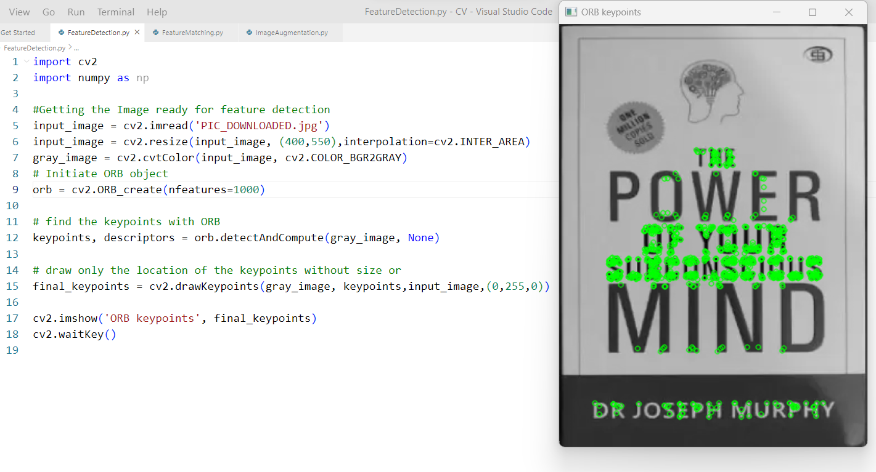

Slide 10
Features Matching
Features matching or generally image matching, a part of many computer vision applications such as image registration, camera calibration & object recognition, is the task of establishing correspondences between two images of the same scene/object.
A common approach to image matching consists of detecting a set of interest points each associated with image descriptors from image data.
Once the features and their descriptors have been extracted from two or more images, the next step is to establish some preliminary feature matches between these images.
Performance of matching methods is based on interest points , depends on both the properties of the underlying interest points and the choice of associated image descriptors. Thus, detectors and descriptors appropriate for images contents shall be used in applications.

Slide 11
FLANN(Fast Library for Approximate Nearest Neighbors) Matcher
Here Feature matching between two images is implemented using FLANN, it is an image matching algorithm for fast approximate nearest neighbor searches in high dimensional spaces.
It contains a collection of algorithms optimized for fast nearest neighbor search in large datasets and for high dimensional features.
A FLANN based matcher with knn is used to match the descriptors in both images. We use cv2.FlannBasedMatcher() as the FLANN based matcher. For FlannBasedMatcher, it accepts two sets of options which specifies the algorithm to be used, its related parameters etc.

Slide 12
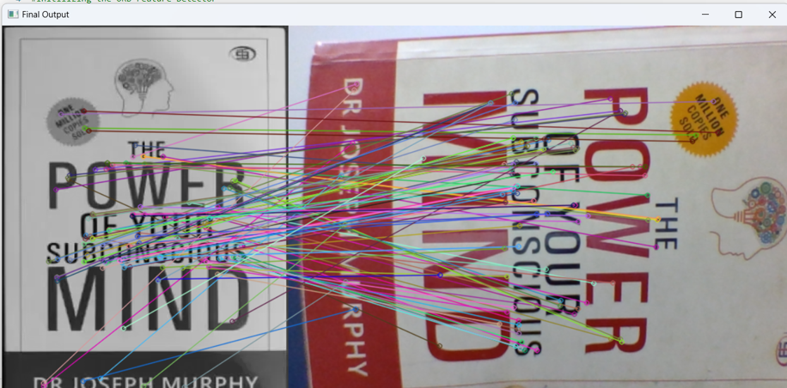
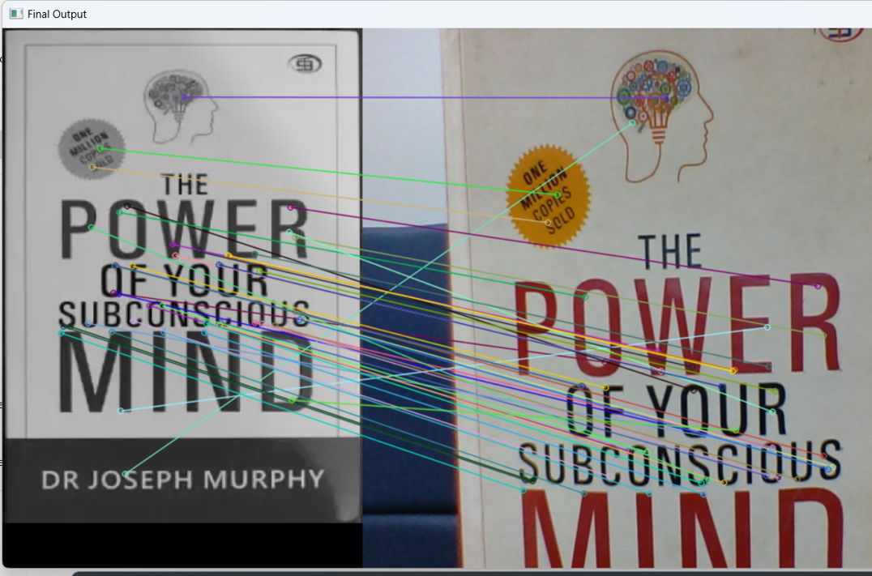
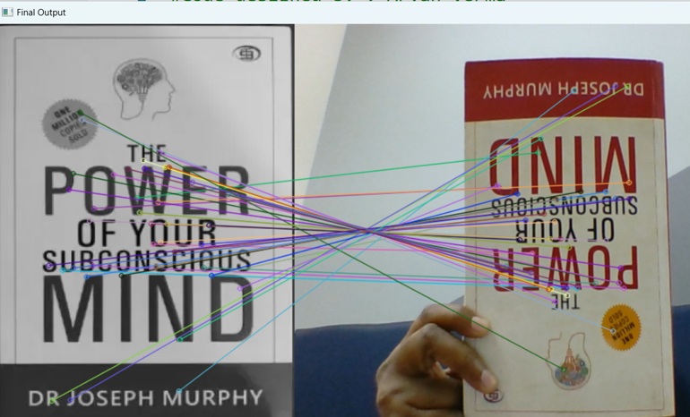

Slide 13
Image augmentation :
Data augmentation is a technique that can be used to artificially expand the size of a training set by creating modified data from the existing one.We can augment:
Audio
Text
Images
Any other types of data
Image Augmentation artificially creates training images through different ways of processing or combination of multiple processing, such as random rotation, shifts, shear and flips, etc.Generally it is done by s/w development kit like ARCore, but here we are using python for image Augmentation.
Here , the concept of homographic matrix is also used. Homography is a transformation that maps the points in one point to the corresponding point in another image

Slide 14
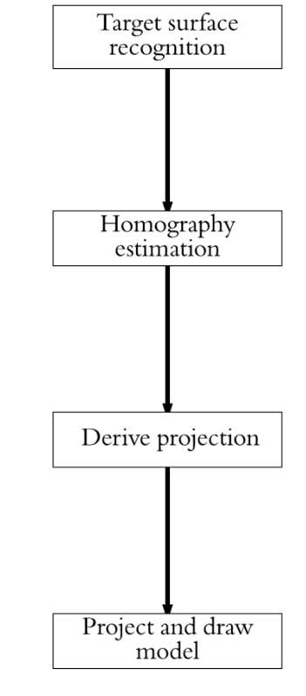
We are applying custom AR,Custom augmented reality is a technology that allows users to superimpose computer-generated images on their view of the real world. This technology has been used in a variety of applications, including video games, movies, and product demonstrations.
STEPS:
Steps to use OpenCV and a homographic matrix to implement augmented reality in an image :
Load the image and the reference object image
Find keypoints and descriptors of the reference object using a feature detection algorithm (ORB)
Match the keypoints and descriptors of the reference object and the image
Establish a homographic matrix using RANSAC
Warp the reference object to align with the image
Overlay the reference object on the image
Display the augmented reality output.

Slide 15
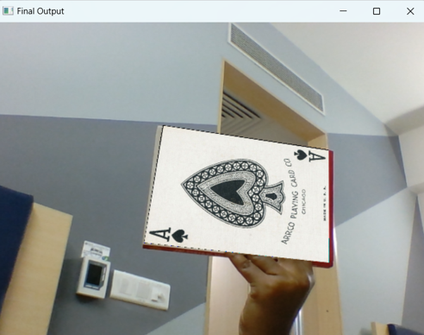
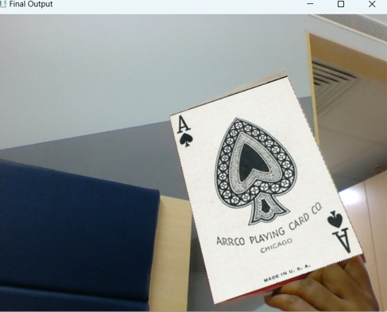

Slide 16
CONCLUSION:
In conclusion, the implementation of augmented reality in image processing using OpenCV and homographic matrices is a powerful technique for enhancing images with virtual content.
By detecting a reference marker or object in the image, the homographic matrix can be used to accurately align and overlay virtual content in real-time.
The process of detecting features, calculating the homographic matrix, and projecting virtual content onto the image can be iterated to augment multiple images.
The use of OpenCV and homographic matrices in augmented reality projects provides an efficient and flexible solution for image enhancement and manipulation.

